Slide 1
Introduction to Pathology Informatics
Session 9: System Implementation and Management
James Harrison, MD PhD
University of Virginia
2023
API distribution, version 1.0
Notes:
These 10 slide sets and term lists are being provided through the Association for Pathology Informatics (API) with a license that allows free use, modification, and redistribution with attribution (see the permitted uses slide at the end of each presentation). The design has been kept relatively basic to make editing and adaptation easier. Users are encouraged to modify and improve the slides, share the changes (with attribution of the original material), and possibly contribute the improved slide sets back to the API or other distributors. As designed, the slides are relatively wordy so that they are easier to follow without an instructor’s guide (though one may appear in the future). Feel free to edit the slides to streamline them and optimize them for local teaching style and available time. Some sessions contain optional slides with extra detail, and these are indicated in the slide notes. Some sessions contain slide builds (most are simple) that don’t print well; these sessions have optional slides for printing, and these are indicated in the slide notes.
The goal of these slide sets is to provide foundational information that will allow pathology trainees to more effectively learn and practice pathology, not to teach the performance of specific tasks in pathology. The overall learning objectives are listed on the third slide of session 0 with some explanatory comments in the notes. Subsequent sessions have agendas but not separate learning objectives because the learning objectives remain the same.
The slides have been used with a teaching schedule in which the orientation is given during the summer and then the remaining sessions are give once a month (with lunch) from September to May. They could also fit into a 2, 4, or 5-6 week teaching module if taught on a weekly/semiweekly basis.

Slide 2
Implementation and management agenda
Appreciate the breadth of activities in pathology IT
Understand the major tasks and governance of the pathology IT team
Understand pathologists’ responsibilities related to IT, red on slides
Understand the general outlines of the software selection and installation process
Be aware of continuing pathology informatics and data challenges

Slide 3
Management of IT systems
Improvement
Strategy
Evaluation
Process improvement
Culture change
Clinical & business alignment
Portfolio management
Strategy
Design
Change control
Operation
Improvement
Ops management
Service desk
Event management
System architecture
Capacity management
Service catalog
Operation
Design
Change management
Deployment & release
Knowledge management
Change control

Slide 4
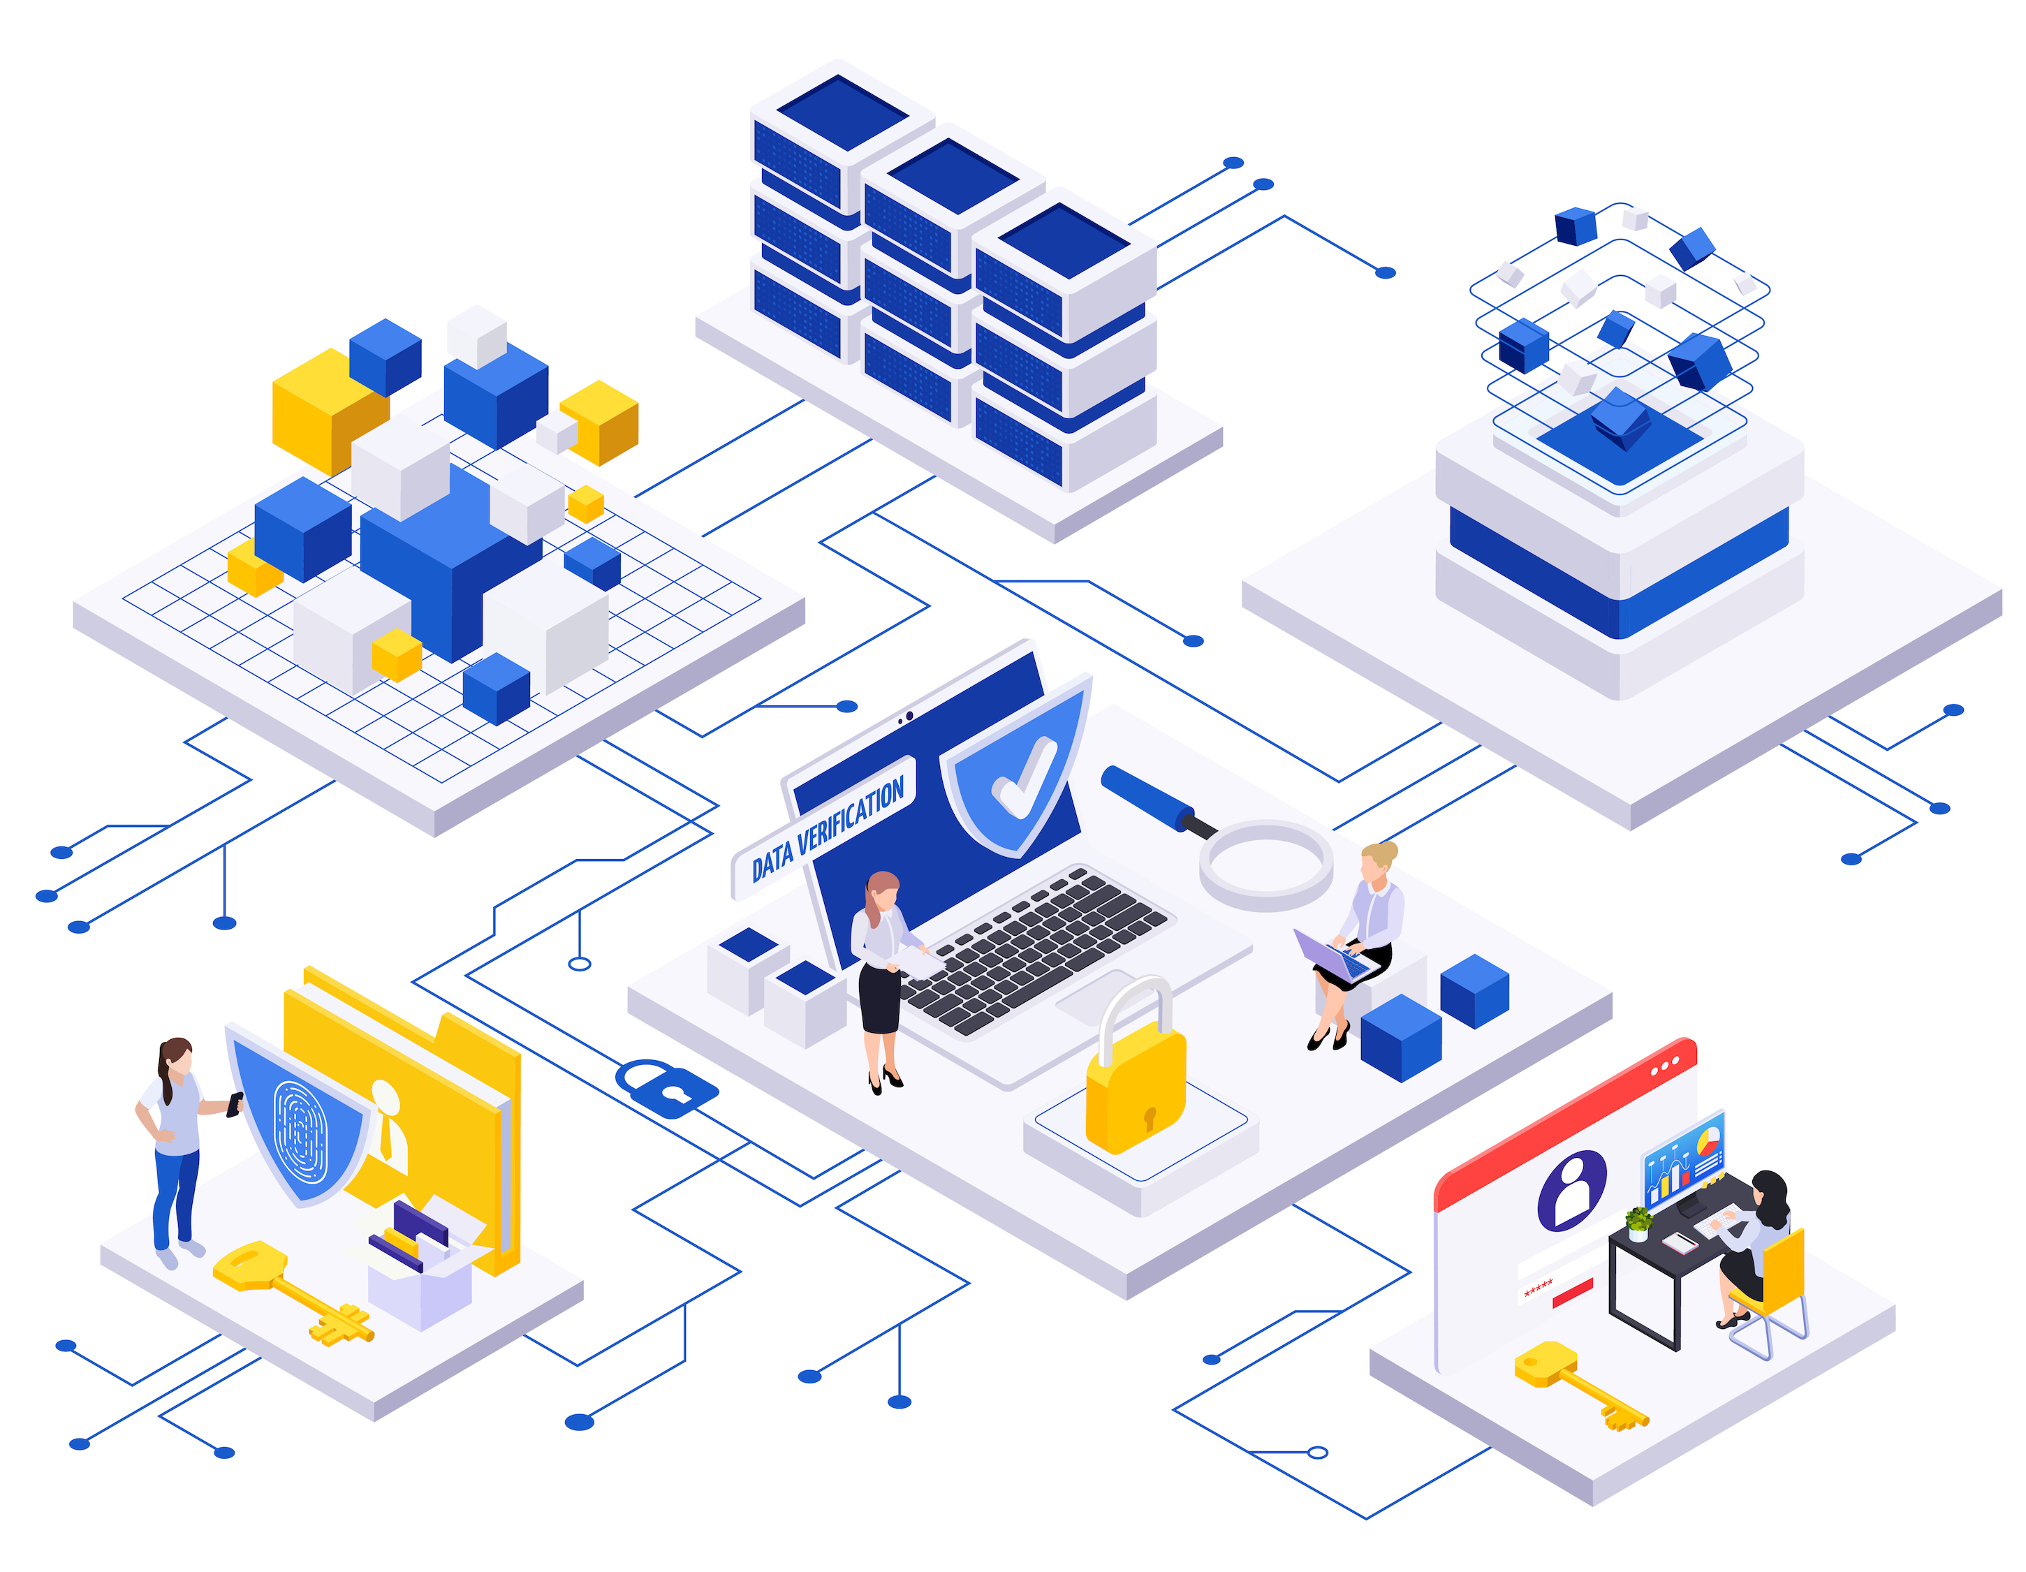
Scope of pathology IT
Systems
Tasks
LIS, APLIS, middleware, instruments
Blood bank system
Outreach order/result and interface systems
Voice recognition/dictation systems
Point of care base stations/devices
PACS and image digitization
Document management system
Fax & print servers
End-user computers
Issue tracking system
Update maintenance tables/dictionaries
Orders, tests, instruments, comments, rules
Personnel and location information
Interface mappings
Train users
Resolve user problems (24/7)
Resolve system/interface errors (24/7)
Schedule & install software/fixes/upgrades
Change management and testing
Backup and restore/rebuild/verify
Regular checks for correct operation
Operational reporting & data extracts
Image by macrovector on Freepik

Slide 5
Pathology IT application management group
Application support
Pathology software applications
Sysadmin and network admin by central IT
Makeup
Combination of IT and med tech
Governance
Pathology dept. vs. hospital IT
Changing with consolidation of EHR software
Specifics of governance matter less than focus, makeup, and collaboration
Laboratory IT administration
Hospital
Medical
IT Admin
Lab Director
IT Super
Pathologists*
Techs
Notes:
*May include a pathologist-informaticist as the specialty expert and section director

Slide 6
Pathology IT application management group
Application management
Pathology software applications
Sysadmin and network admin by central IT
Makeup
Combination of IT and med tech
Governance
Pathology dept. vs. hospital IT
Changing with consolidation of EHR software
Specifics of governance matter less than focus, makeup, and collaboration
Laboratory administration
Hospital
Medical
Lab Admin
Lab Director
Lab Super
Pathologists*
Techs
Notes:
*Specialty experts, section directors

Slide 7
Key software application management tasks
Content and configuration management (previously discussed)
Performance monitoring
Interface management
Change management
Data and system backup
Procedure manual
Image by vectorjuice on Freepik

Slide 8
Performance monitoring
System testing
Regression testing, repeating previous testing
Automated testing with a test data library and test scripts
Every two years for calculations, executable rules, reports, display
Unit, integration, system, acceptance testing in later slides
Network testing (in-lab networks)
Throughput, collision rate, downtime
Scheduled and unscheduled system downtime
System response times and interface transfer rates
Stored data volume and disc space
Total accounts used and available licensed accounts
System and interface error logs
Issue tracking
Image by vectorjuice on Freepik

Slide 9
Interface management
LIS
Coordination of vendors of systems to be interfaced ($10-40K)
Creation of a test data library
Mapping data elements between the two sides of the interface
Installation of the interface
Configuration of an interface engine if using
Testing and validation of the interface (test library and scripts)
Signoff of testing
Documentation of the interface
Written procedures with signoff
EHR
Out-reach
Interface Engine
Dec Supp
Inst
Mgr
Public
Health

Slide 10
Change management (“change control”)
Change control documentation
Goals
Avoid unnecessary and unauthorized changes; protect the data; maintain defined architecture
Make necessary changes efficiently with minimal disruption (requires planning)
Test and validate changes
Library of test data and automatic testing scripts to check all functions
Review and signoff of testing results
Document and monitor all changes
Extensive validation for blood bank systems
Item | Comment
Description of change | Detailed explanation
Reason for change | Needs and benefits
Personnel responsible | Who will perform the change
Category | Hardware, software, process, or procedural
Magnitude | Minor vs. major based on impact
Signoff | Acceptance responsibility
Risk assessment | Anticipation and planning for problems
Evaluation/ monitoring | Assessment of success, problem detection
Adapted from Cucoranu IC, 2015.

Slide 11
Data and system backup
Tape commonly used; slow but inexpensive and high data volume
Frequency: What you can lose and/or reconstruct from database logs
Multiple backups in case of backup corruption
Rotating backups
Daily, weekly, monthly
Incremental backup
Rotate to off site storage and back
“Hot backup:” may be off-site
Disks or full duplicate systems
Failover, manual or automatic
External interfaces often need manual resetting to new addresses
Traditional GF-F-S backup rotation
Sons: 4 daily backups
M
T
W
Th
1
Fathers:
4 weekly
backups
2
3
4
1
2
3
4
5
6
7
8
9
10
11
Grandfathers: 11 monthly backups

Slide 12
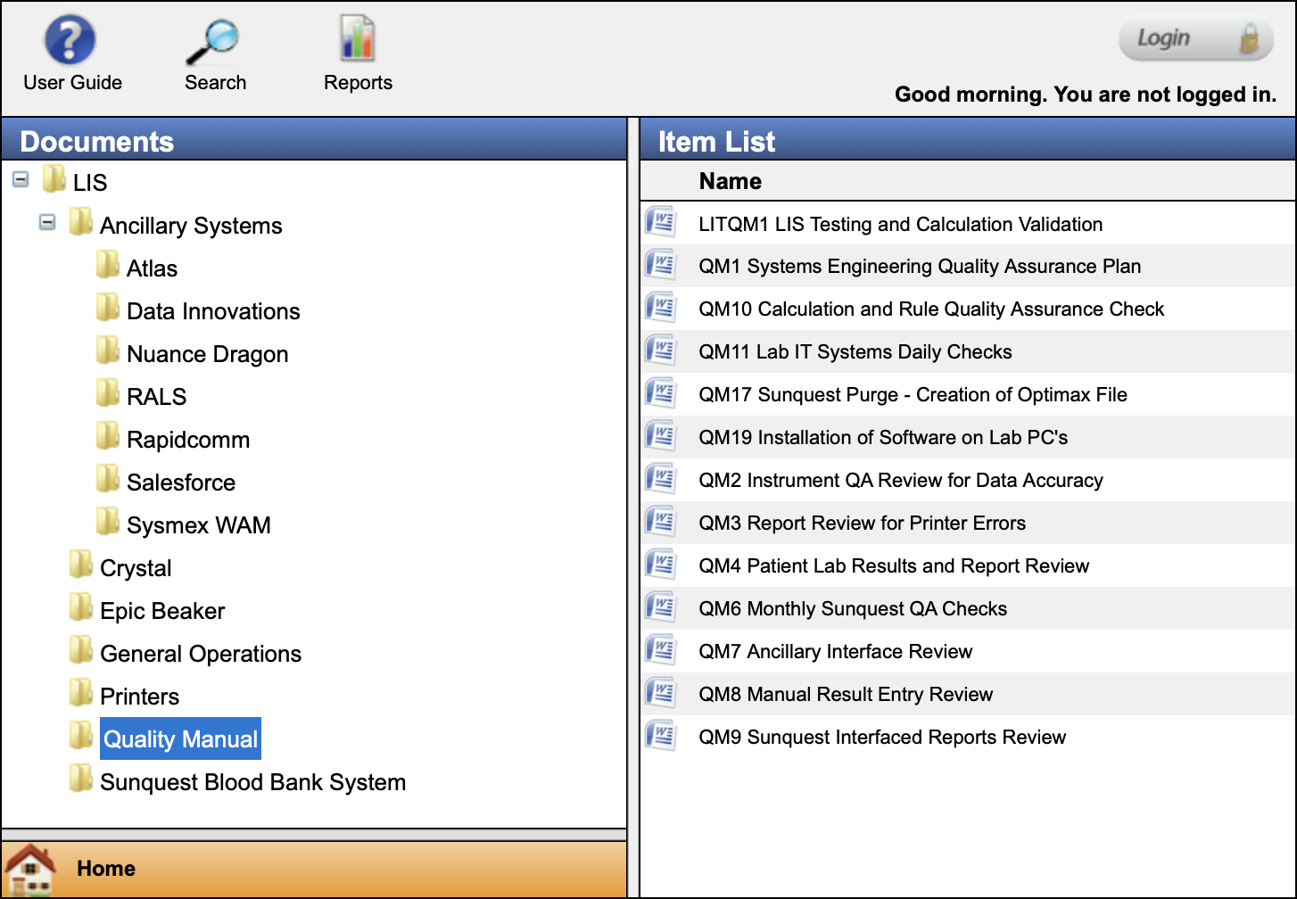
Laboratory IT procedure manual
Lab Procedure Manual
73 total procedures in this example
Major sections (see Harrison, Table 6-6)
General operation
LIS: System description, startup and shutdown, backup and data archiving, downtime procedures, error resolution, printer management
Other systems, docs similar to LIS
Interfaces
Reports
Quality assurance
Security
Disaster recovery
Pathologist signoff
Adapted from Harrison J, 2019.

Slide 13
Software selection and installation
LIS lifecycle
Software project/development styles
Defining requirements
System selection process
Software licenses
Installation and testing
User training
Go-live
Software as a service (SaaS) vs. local hosting
Image by storyset on Freepik

Slide 14
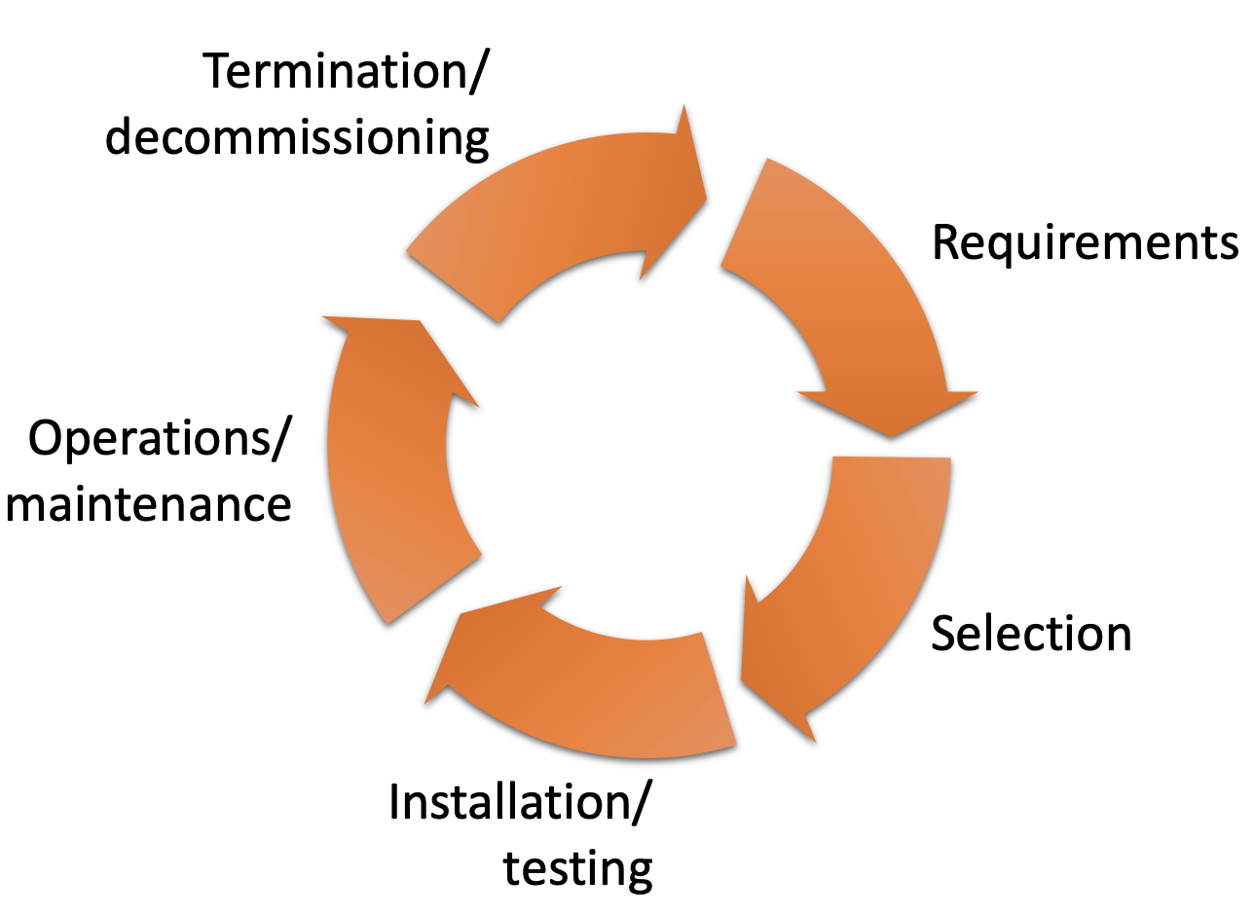
LIS system lifecycle
Lifespan 10-20 years or more
Recent replacements more related to EHR adoption than lab needs
Stages
Requirements & goals
System selection
Installation and testing
Operations and maintenance
Termination and decommissioning (SaaS?)
Selection and installation may take 1-2 years, less for smaller systems
Software
Lifecycle

Slide 15
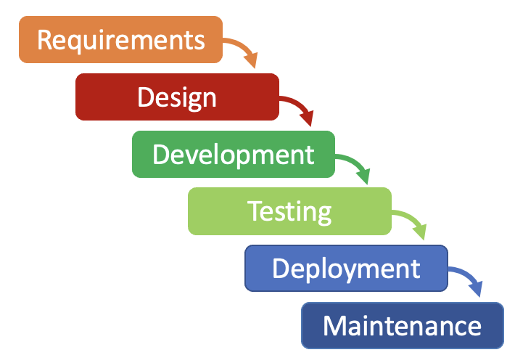
Software/IT project styles
Waterfall
Progressive from requirements definition to software deployment
Software available at end
Spiral/Incremental
Development/deployment cycle that progressively adds features
Interim software available for review and use
Agile
Users and developers work together in short sequential bursts (sprints) to finish components of the project
Spiral/Incremental Model
Test
Plan
Maintenance
Waterfall
Model
Develop
Design
Agile Model
Developers
Users
Plan – Design – Develop – Test – Deploy – Review – Launch

Slide 16
Setting requirements and goals
Identify stakeholder groups
Identify project management, possibly from a project management office
Establish steering committee with stakeholder representation
Stakeholder workgroups
Project champions in stakeholder areas
Define desired business outcomes
Determine current barriers needing removal
Develop requirements document
Functional and non-functional
Briefly review available vendors
Functional
Requirements
Non-functional
Requirements
What the system should do
Features
Organizational and user needs
How the system should do it
Properties
Expectations

Slide 17
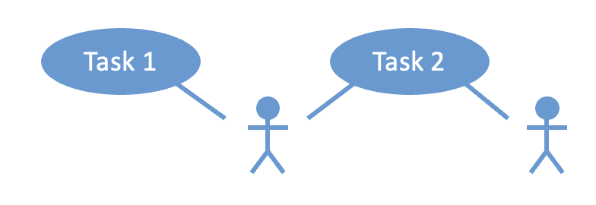
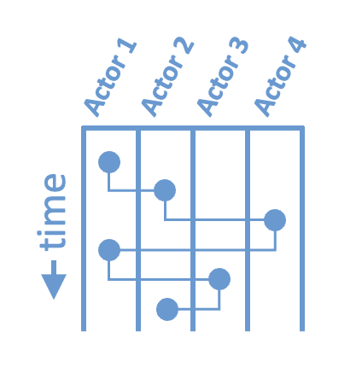
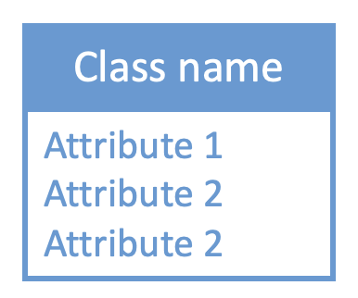
Tools for discussing system requirements
Actions
Use case graphs
Who does what
Activity (swim lane) graphs
Flow of work and information
Class diagrams
Data model
Actors (human or system)
Actors (human or system)
Flow of tasks and transfer of data
Detailed description of
complex data objects and their elements
See Harrison J, 2019, pp. 114-116.

Slide 18
System selection: RFI
Request for information (RFI) to promising vendors
Customer self-description
Description of the organization and its culture
Goals, needs, and desired outcomes
Functional requirements and constraints
Support requirements
Request for vendor and software description
Brief overview of how software meets goals
Vendor’s organizational philosophy, history, size, financial status, and stability
Number and characteristics of installed sites
Contact information for reference sites
Criteria for evaluation of RFI responses
RFI
Request for information
RFP
Request for proposal
Exploring market
Looking for overviews
Understanding products
Understanding cost
Detail on process
Finding strategic partner
Educates
Compares
RFI
RFP
Adapted from the RFP360 infographic

Slide 19
System selection: Initial ranking
Review RFIs and rank
Schedule vendor demos with stakeholders
Visit reference sites
See Harrison 2019 chapter appendix for questions to ask
Go beyond the feature checklist and company size
Evaluate implementation quality and workflow fit

Slide 20
System selection: RFP
Requests for proposals (RFP) to top vendor(s)
Prepare in collaboration with procurement office
Vendor may have RFP templates
Extend RFI with additional sections
Description of installation process, including handling legacy data
Cost and licensing terms
Support style and cost
Select vendor and negotiate contract (procurement office)
RFI
Request for information
RFP
Request for proposal
Exploring market
Looking for overviews
Understanding products
Understanding cost
Detail on process
Finding strategic partner
Educates
Compares
RFI
RFP

Slide 21
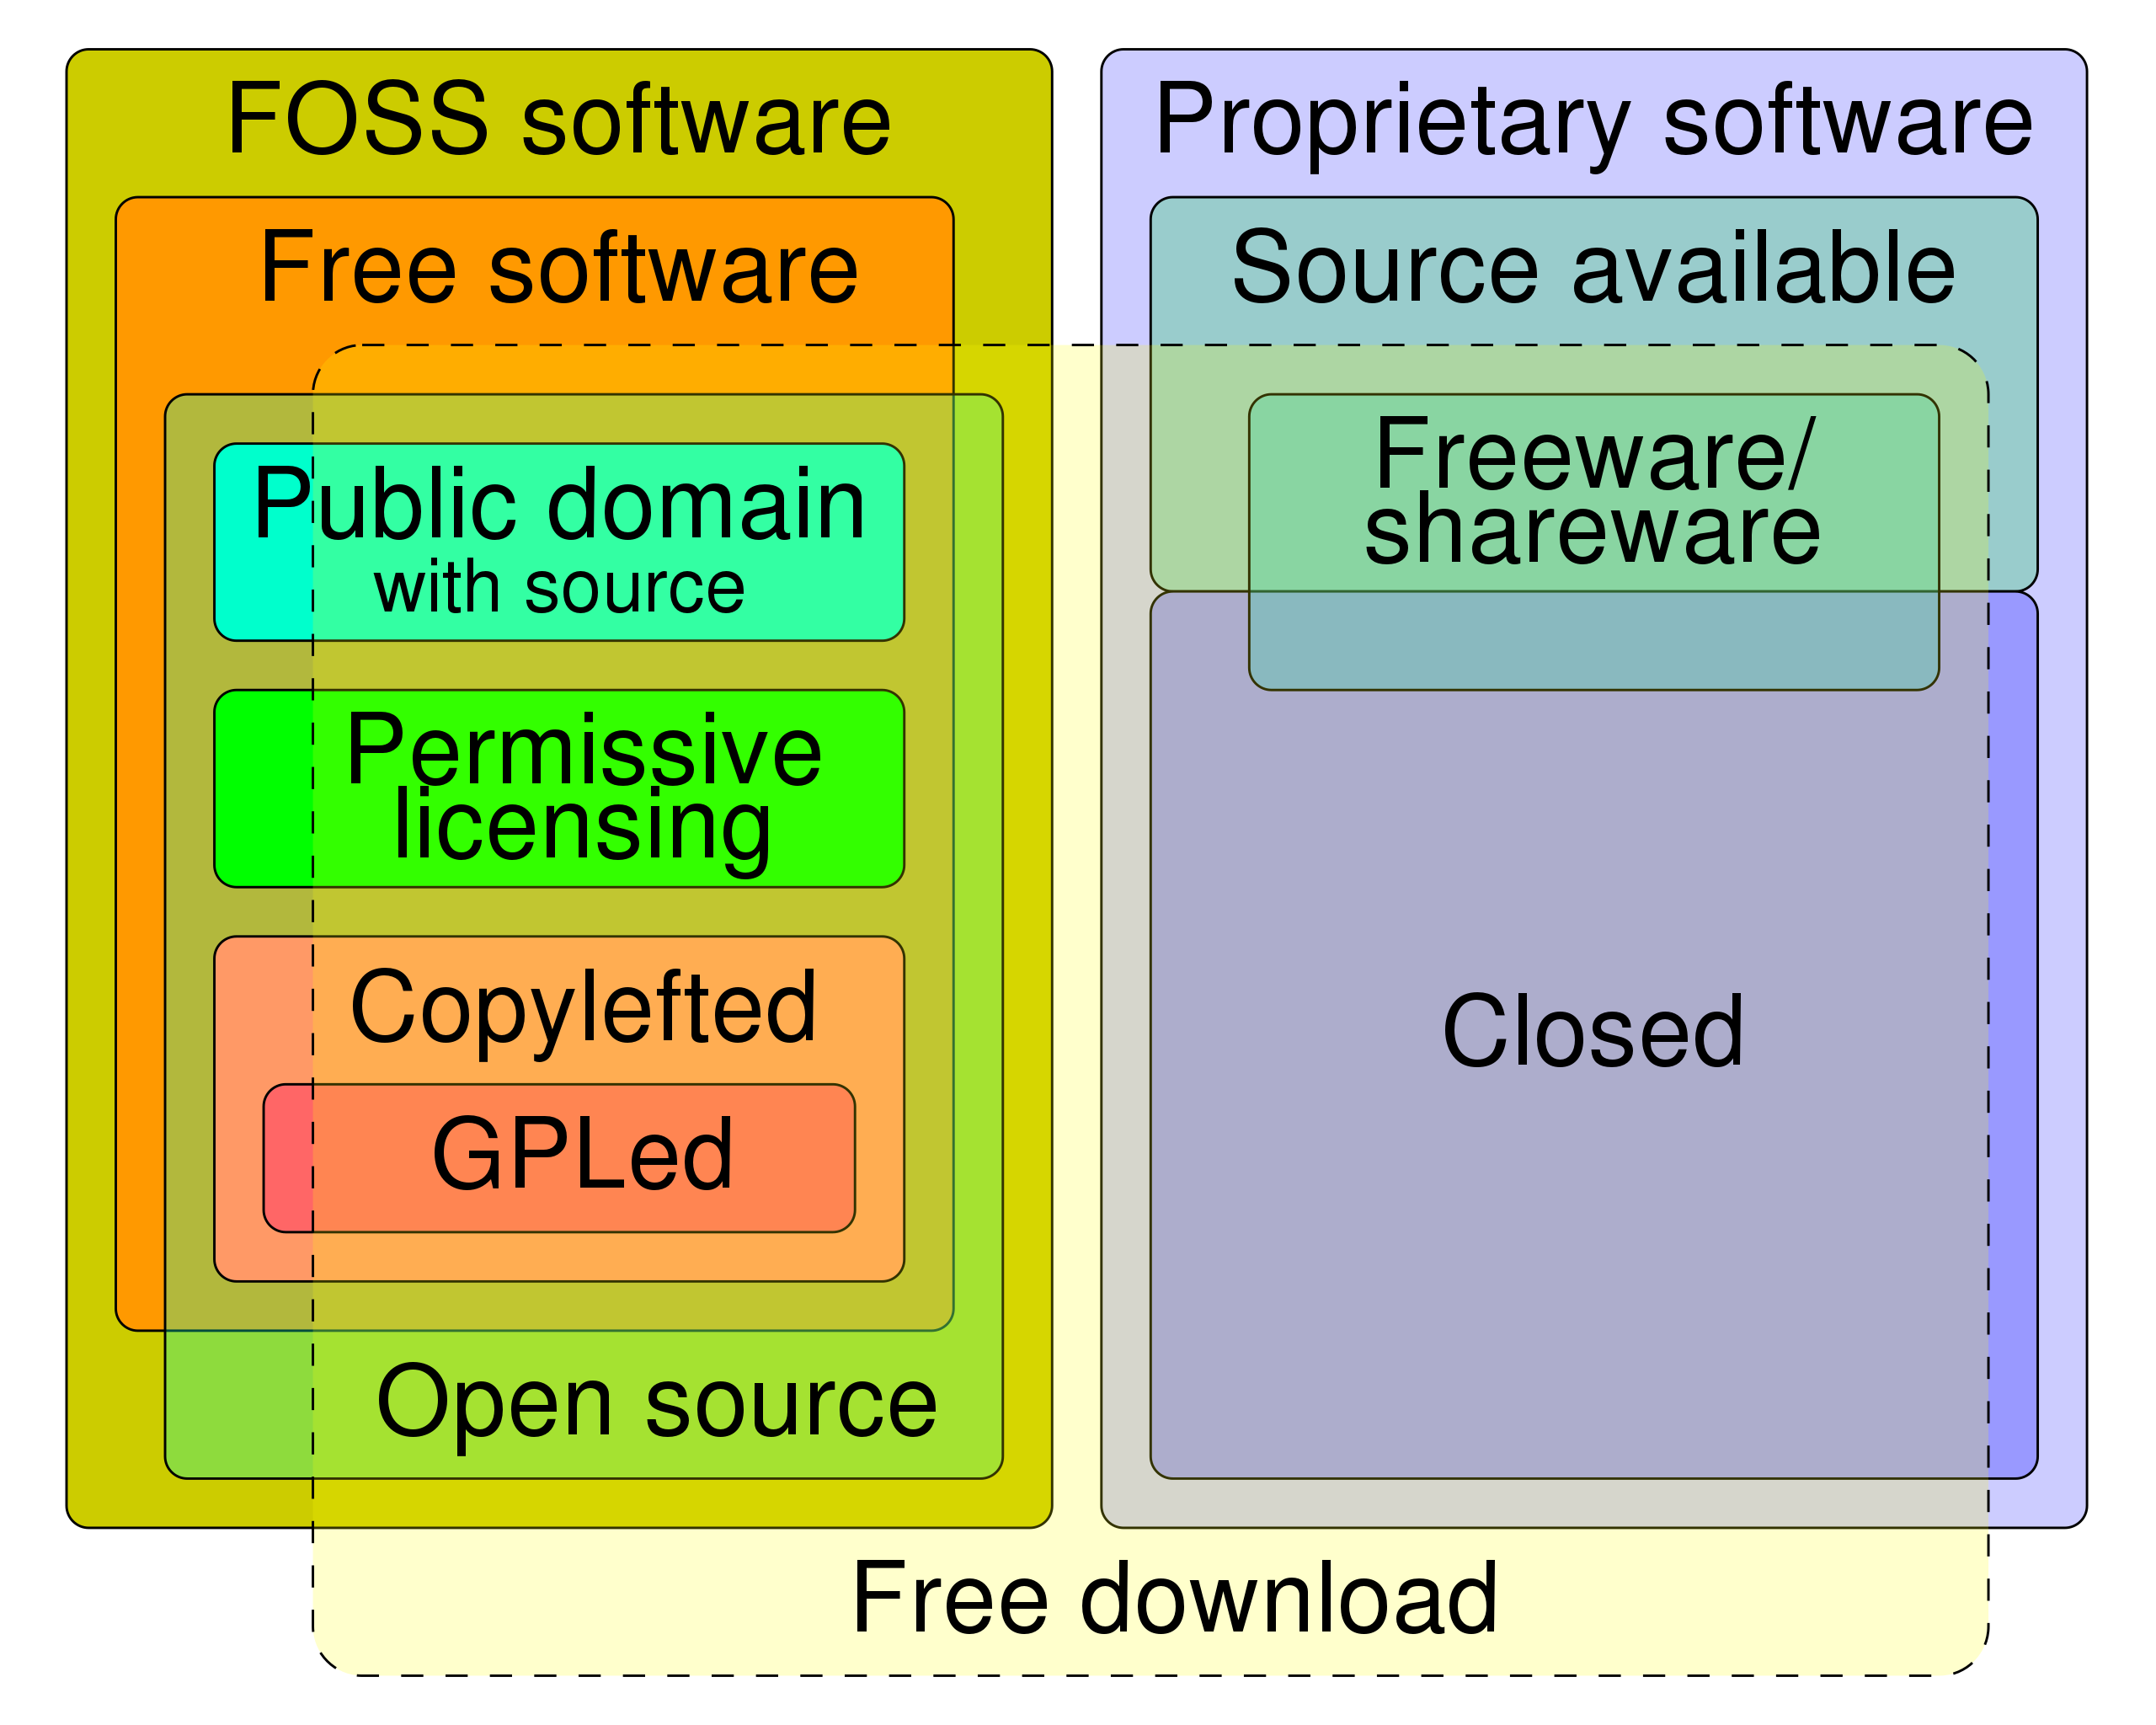
Software licenses
Types of software licenses
Software is copyrighted or patented
Users are licensed
License specifies how software can be used and redistributed
Proprietary
Seat licenses (# accounts)
Connection licenses
Subscription vs. purchase/upgrade
Free and open source (FOSS)
Public domain
Permissive (BSD, MIT)
Restrictive (GPL, copyleft)
Redistribution must maintain the same license
https://en.wikipedia.org/wiki/Software_license

Slide 22
Installation
Detailed implementation plan on contract completion
Overall timeline and milestones for system construction
Vendor resources provided and customer resources required
User training plan and schedule
Vendor and customer deliverables (local configuration, review, and signoff)
Projected go live date
For large systems, installation managed by vendor & customer jointly
SaaS less involved but also requires configuration, data loading, training, etc.
Notes:
Large software systems are more like erector sets than complete finished programs like word processors or spreadsheets. Don’t count on the vendor to know how to do everything, systems and sites aren’t that standardized yet.

Slide 23
New software testing
Testing using vendor test scripts and customer data
Testing plans with established acceptance criteria
Unit testing
Internal operations of software modules in isolation
Integration testing
Operation of a new module in combination with interacting modules
System testing
Evaluation of the system as a whole; focus on many modules working together
Acceptance testing
Evaluation of satisfaction of business and regulatory requirements
Customer review and signoff of testing results
Notes:
Large software systems are more like erector sets than complete finished programs like word processors or spreadsheets. Don’t count on the vendor to know how to do everything, systems and sites aren’t that standardized yet.
These testing types are easy to write multiple choice questions about and often end up on board and recertification exams.

Slide 24
User training
System managers trained early and help with installation
Superusers extend managers in stakeholder areas and help train routine users
User training ideally about two weeks prior to go live
Earlier training tends to fade
Organization of ongoing training for refresh and changing user roles
May be transferred to customer after go-live, or available at extra cost

Slide 25
Go-live
Each has unique challenges
New system startup vs. replacement of old system with changeover
Contingency plans for failure and fallback, extra staff
Followed by a period of lower productivity and error risk
Workflow design issues may be revealed
Dealing with errors or “edge cases” may be challenging
Possibility of adjustment period before operation is routine
May require extra vigilance and work
Possible negative perceptions of the new system

Slide 26
What about SaaS?
SaaS Application
Application logic and
data in the cloud
LIS “in the cloud”
Expert system administration at SaaS cloud site
No local hardware management/maintenance
Application management can be local team or vendor staff
Does not change pathologist responsibilities
Control of data (cost of reporting/termination)
IT procedure manual
Should be accurate and shared with local site
Signed off by pathologist (CAP checklist requirement)
Testing including validation of rules and interfaces initially and ongoing
Reviewed and signed off by pathologist (CAP checklist)
API
Interfaces
Other Local Systems

Slide 27
Pathology informatics and data challenges
Checklist items
31 items in Lab Gen; a few others scattered
AP report formatting in downstream systems
No consensus on an open document formatting/display standard
Plain text formatting, lack of useful tables, line wrap problems, overall suboptimal display
RTF, OpenDoc, HL7 CDA, XML or xhtml with style sheets are possibilities
Flexible formatting necessary for different displays (ie, handhelds)
PDF/RTF/OpenDoc designed for physical pages, not electronic displays
Inclusion of structured data with narrative, for analytics & decision support
XML/CSS meets requirements, need consensus & editing software
Vendors don’t standardize themselves; customers don’t know what to ask for
For more detail, see Wilkerson ML et al., 2015

Slide 28
Pathology informatics and data challenges
Test naming
Analyte, synonyms, disease, use context, draw/handling instructions
Interoperability of results
Can lab data be transmitted, displayed, and interpreted clinically across systems?
When should tests display together in a lab flow sheet or graph?
No data elements currently with results to indicate clinical interoperability
Representation of gender
How is gender represented in the system? Is the representation adequate for clinical needs?
Which representation should be used for eGFR calculation? For choice of reference range to display?
Future orders, implementation and processing
Valid date range and order release, matching to correct encounter, and duplication with multiple providers
Duplicate orders
Auto-cancellation, communication of cancellation, reinstatement?
For more detail, see Wilkerson ML at al., 2015.

Slide 29
Key points
Governance of pathology IT systems is a cooperative activity
Similarities to managing the clinical laboratory
Understand the important tasks in system management
Content and configuration management, performance monitoring, interface management, change management, data and system backup, procedure manual
Understand the important tasks in software selection and installation
Software lifecycle, setting requirements, product ranking using RFI and RFP processes, software licensing, installation/testing, user training, go-live, SaaS
Challenges in pathology data and system management
Informatics in lab inspections, AP report formatting, test naming, interoperability, representation of sex & gender, future orders and duplicate orders

Slide 30
Readings
Harrison J. Management of Pathology Information Systems, Chapter 6. In: Laboratory Administration for Pathologists. 2nd ed. CAP Press; 2019. pp. 106-112, 114-116 (“Diagramming tools”), and appendix. Available for download from the Pathology Informatics Essentials for Residents curriculum page.
Cucoranu IC. Laboratory information systems management and operations. Surgical Pathology Clinics. 2015;8(2):153-157. doi:10.1016/j.path.2015.02.002
Wilkerson ML, Henricks WH, Castellani WJ, Whitsitt MS, Sinard JH. Management of laboratory data and information exchange in the electronic health record. Arch Pathol Lab Med. 2015;139(3):319-327. doi:10.5858/arpa.2013-0712-SO

Slide 31
Permitted uses
© 2023 James H. Harrison, Jr. except as noted below. The original material in this slide set is made available under a Creative Commons Attribution 4.0 (CC BY 4.0) International License. The contents may be used without restriction, modified, and redistributed if they are attributed and any changes are indicated. Some graphical elements are used with permission or according to their own licenses requiring attribution. Attribution links are provided on the slide of use or on the Permitted Uses slide (this slide). These elements may be used and included in modified and redistributed work consistent with the licenses specified at the linked sites, provided that the links are included in the redistributed material.
The cover image is a composite of two laboratory images from Pixabay available for use without attribution.
Sitting icon created by Prosymbols Premium – Flaticon
Dedicated hosting icon created by phatplus – Flaticon
Agile icon created by Flat Icons – Flaticon
Spiral icon created by Pixelmeetup – Flaticon
Agenda, functional, and quote icons created by Freepik – Flaticon
Organization icons created by Smashicons – Flaticon
Bulb icon created by logisstudio – Flaticon
Compare icon created by Buandesign – Flaticon
Testing icon created by smashingstocks – Flaticon
Training icon created by Nikita Golubev – Flaticon
Launch icon created by nawicon – Flaticon
Key icon created by juicy_fish – Flaticon
Book icon created by Good Ware – Flaticon

